Slide 1
Unravelling Patterns: A Review of Machine Learning Algorithms - Comparisons and Insights for Enhanced Geospatial Insights
K CHAITRA LATHA
MCA in DATA SCIENCE

Slide 2
"Geospatial Data Classification Using ML: An Overview"
This project investigates the application of various ML algorithms, including supervised, unsupervised, and deep learning models, to enhance geospatial data classification and trend analysis. Using tools like Google Earth Pro and QGIS, satellite imagery from Delhi was processed into multiple bands (urban, water, forest, and other categories). By leveraging for classification, the project evaluated the effectiveness of these methods in predicting and mapping geographic patterns. The extracted data was refined into training and testing sets, facilitating a comprehensive performance comparison. This research aims to provide robust, data-driven recommendations for researchers and policymakers by optimizing classification accuracy and geospatial insights across diverse landscapes.

Slide 3



Types of Algorithms
Random Forest.
ANN Neural Network.
Logistical Regression.
K-Means

Slide 4
Earth Explore
To study Earth's features, including urban areas, forests, water bodies, and ecosystems, using satellite imagery and geospatial data. This helps in making informed decisions on sustainability, resource management, and development planning.
Libraries : Geopandas , Raster, Matplotlib.
Data Formats : GeoTIFF, shapefiles, CSV , JSON
Handling cloud cover and image noise in satellite data

Slide 5
Google Earth Pro
To classify or analyze different land cover types (e.g., urban , water, forests , Others) using training and testing datasets selected from satellite imagery and It offers advanced tools for mapping , measuring distance and analyzing geographic trends in Google Earth Pro
Convert KML/KMZ to a format compatible with your analysis tool (e.g., GeoJSON, CSV)
With only 30 training and 10 testing points, the model's performance may be limited. Increasing sample size and diversity can improve generalization.

Slide 6
QGIS
(Quantum Geographic Information System)
Display vector (points, lines, polygons) and raster (satellite imagery, elevation models) data.
Add, delete, or modify features and attributes of spatial data.
Vector Data : Shapefiles (.shp), GeoJSON, KML/KMZ, CSV.
Raster Data : GeoTIFF.

Slide 7
Research Methodology
Data Collection
Source: Earth Explorer and QGIS software.
Year: 2014,2016,2020,2024 satellite imagery of Delhi.
Categories: Urban areas, water bodies, forests, and others.
Data Preparation
Extraction and processing of raster files for different land-use categories.
Preprocessing steps include data cleaning, normalization, and resizing.

Slide 8
Random Forest
To accurately classify forest areas in geospatial data using machine learning.
Extracted from the raster file. Forest_Training_Extracted.tif.
Flatten raster data into 2D arrays.
Assign labels (Class 1) to forest pixels.
Combine forest data with other class data (urban, water, others)

Slide 9
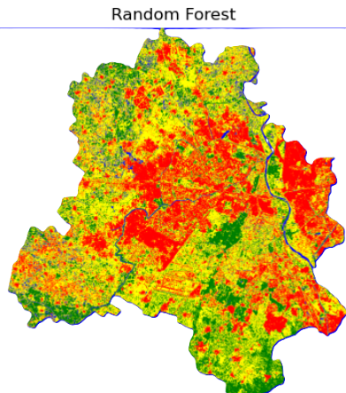
Random Forest: Comparable accuracy to ANN with better interpretability
Forest areas are shown in dark green.
Visual comparison of classified images for each model.
Random Forest and ANN accurately classify forest regions.

Slide 10
ANN Neural Network
To classify geospatial data using artificial neural networks (ANNs) for improved land cover identification
70% training, 30% testing split using train_test_split.
Multi-Layer Perceptron (MLP) Classifier
Configuration:
Hidden layers: (100, 50)
Maximum iterations: 500
Random state: 42

Slide 11
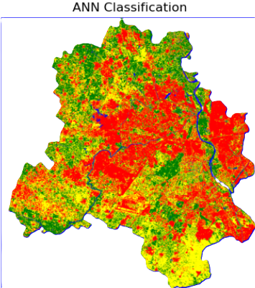
Model Comparison:
Logistic Regression: Moderate accuracy, struggles with complex boundaries.
ANN: High accuracy, handles non-linear patterns well.
Random Forest: High accuracy, robust to noise.
K-Means: Clustering without accuracy in classification context.

Slide 12
Logistical Regression
1. Load and preprocess raster data.
2. Assign labels to each land cover type.
3. Normalize the data using StandardScaler.
4. Train Logistic Regression model on training data.
5. Evaluate model performance with classification report and accuracy score.
6. Classify entire raster bandstack using the trained model.

Slide 13
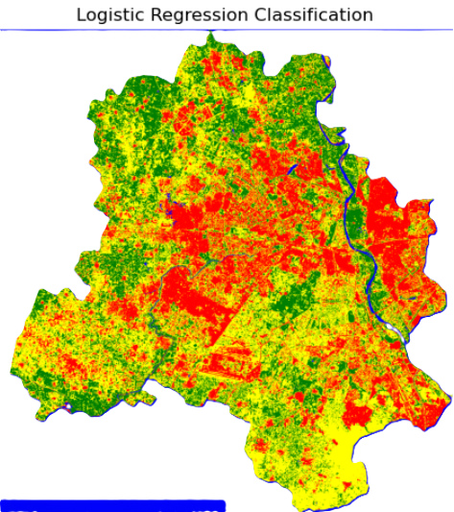
- The model is trained on a dataset with 70% training and 30% testing split.
- Evaluation metrics include accuracy and a classification report.
The accuracy score provides an overall measure of performance.
Logistic Regression is effective for raster data classification, providing reasonable accuracy and interpretability.
Future improvements include incorporating additional features and optimizing hyperparameters.

Slide 14
K-Means
This project involves clustering raster pixel data using KMeans and evaluating cluster quality with silhouette scores.
The dataset includes raster data for forest, urban, water, and others categories.
Forest: Raster data for forest regions
- Urban: Raster data for urban areas
- Water: Raster data for water bodies
- Others: Miscellaneous regions

Slide 15
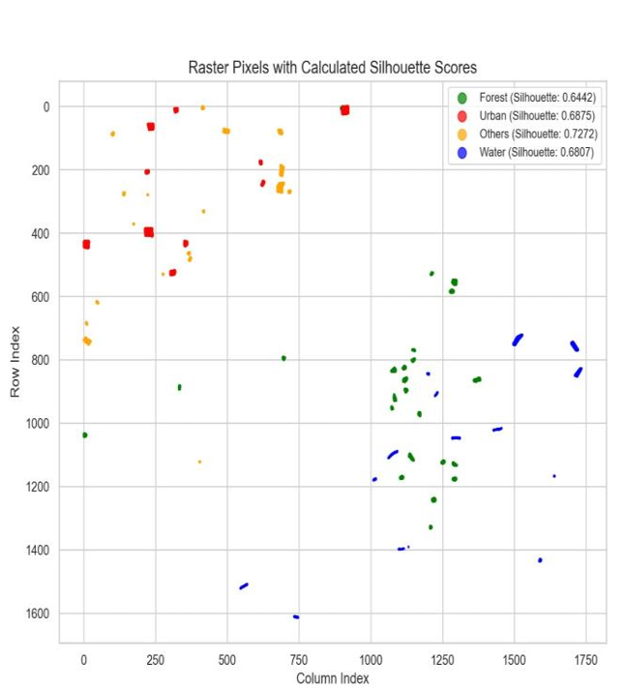
1. Read raster files and extract non-zero pixel coordinates.
2. Apply KMeans clustering with 2 clusters.
3. Calculate silhouette scores to evaluate clustering quality.
4. Visualize clustered pixels using scatter plots.
The project successfully clusters raster pixel data and calculates silhouette scores to evaluate clustering quality.
Next steps include improving clustering with additional features or categories.

Slide 16
Year | Model | Accuracy | Precision (Macro) | Recall (Macro) | F1-Score (Macro) | Weighted Precision | Weighted Recall | Weighted F1-Score
2014 | Logistic Regression | 0.4427 | 0.64 | 0.25 | 0.16 | 0.61 | 0.44 | 0.27
2014 | ANN | 0.4427 | 0.81 | 0.25 | 0.16 | 0.74 | 0.44 | 0.27
2014 | Random Forest | 0.4428 | 0.81 | 0.25 | 0.16 | 0.72 | 0.44 | 0.27
2016 | Logistic Regression | 0.5167 | 0.68 | 0.25 | 0.17 | 0.62 | 0.52 | 0.35
2016 | ANN | 0.5168 | 0.77 | 0.25 | 0.17 | 0.68 | 0.52 | 0.35
2016 | Random Forest | 0.5169 | 0.85 | 0.25 | 0.17 | 0.73 | 0.52 | 0.35
2020 | Logistic Regression | 0.4427 | 0.70 | 0.25 | 0.16 | 0.65 | 0.44 | 0.27
2020 | ANN | 0.4428 | 0.78 | 0.25 | 0.16 | 0.70 | 0.44 | 0.27
2020 | Random Forest | 0.4429 | 0.83 | 0.25 | 0.16 | 0.73 | 0.44 | 0.27
2024 | Logistic Regression | 0.5169 | 8.77 | 0.25 | 0.17 | 0.67 | 0.52 | 0.35
2024 | ANN | 0.5169 | 8.32 | 0.25 | 0.17 | 8.35 | 0.52 | 0.35
2024 | Random Forest | 0.5170 | 0.85 | 0.25 | 0.17 | 0.74 | 0.52 | 0.35
Results Table

Slide 17
Insights from the Band stack Data Results (2014–2024)
Overall Accuracy Improvement
  Accuracy has improved from 0.44 in 2014 and 2020 to 0.52 in 2016 and 2024 for all models.
  The 2024 results show the highest accuracy (0.52), suggesting some improvement in classification, possibly due to better data quality or changes in class
  distributions.
Model Performance Trends
  Random Forest consistently performs slightly better than Logistic Regression and ANN across all years.
  ANN’s macro precision has high variability, especially in 2024 (where it appears unusually high, possibly due to a data processing issue).
  Logistic Regression and ANN show marginal improvements in accuracy but still struggle with lower recall values.
Challenges in Classifying Certain Classes
  Across all years, Class 4 dominates with high recall (~1.00) and F1-score (~0.61–0.68), meaning most predictions are assigned to Class 4.
  Classes 1, 2, and 3 have near-zero recall, meaning the model struggles to correctly classify these classes. This issue persists across all years and models.

Slide 18
Macro vs. Weighted Metrics
  Macro-averaged precision is much higher in 2024 (possibly an anomaly), whereas weighted precision follows a more reasonable trend.
  Weighted recall remains stable across years (0.44 in 2014 & 2020, 0.52 in 2016 & 2024), reinforcing that the models heavily favor the majority class (Class 4).
Random Forest as the Best Model
  Random Forest achieves the highest accuracy in all years, marginally outperforming the other models.
  However, its recall and F1-score patterns remain similar to the other models, meaning it still struggles with minority classes.

Slide 19


Year | Raster Type | Mean | Variance | Standard Deviation | Min Value | Max Value
2024 | Forest | 11253.03 | 4,466,420.00 | 2113.39 | 8439.0 | 19140.0
2024 | Others | 14899.56 | 11,090,215.00 | 3330.20 | 7663.0 | 25335.0
2024 | Water | 9054.26 | 2,995,780.50 | 1730.83 | 7528.0 | 19652.0
2024 | Urban | 12727.89 | 9,821,717.19 | 991.02 | 10303.0 | 16527.0
2024 | Full Raster | 12659.65 | 7,784,814.50 | 2790.13 | 7210.0 | 53764.0
2020 | Forest | 11917.52 | 9,213,558.00 | 3035.38 | 8393.0 | 20719.0
2020 | Others | 14293.36 | 11,649,300.00 | 3411.11 | 8088.0 | 28096.0
2020 | Water | 9530.12 | 1,790,497.25 | 1338.09 | 7640.0 | 19652.0
2020 | Urban | 13382.14 | 1,256,598.00 | 1120.98 | 10405.0 | 18650.0
2020 | Full Raster | 13162.01 | 7,336,864.00 | 2708.66 | 4687.0 | 54244.0
2016 | Forest | 13716.27 | 3,406,568.50 | 1845.44 | 11290.0 | 19392.0
2016 | Others | 15941.35 | 3,669,259.50 | 1915.53 | 11699.0 | 20159.0
2016 | Water | 13679.50 | 1,221,847.75 | 1105.37 | 11644.0 | 20204.0
2016 | Urban | 14811.98 | 1,029,516.19 | 1014.65 | 12811.0 | 17092.0
2016 | Full Raster | 15104.04 | 3,868,764.25 | 1966.92 | 10833.0 | 31579.0
2014 | Forest | 12486.01 | 6,455,698.50 | 2540.81 | 9243.0 | 20298.0
2014 | Others | 14349.28 | 8,162,493.50 | 2857.01 | 9088.0 | 22726.0
2014 | Water | 10380.59 | 1,836,932.63 | 1355.33 | 8865.0 | 18167.0
2014 | Urban | 14067.14 | 1,645,742.13 | 1282.86 | 11416.0 | 19504.0
2014 | Full Raster | 14299.38 | 6,293,070.50 | 2508.60 | 8180.0 | 56432.0
Statistical Analysis Results

Slide 20
Insights from the Results:
Mean Values:
  The "Others" raster consistently has the highest mean values, indicating it contains the highest pixel values on average across all years.
  "Water" raster types generally exhibit the lowest mean values.
Variance and Standard Deviation:
  The "Others" raster has the highest variance, particularly in both 2020 and 2024, suggesting a wide range of values.
  The "Urban" raster shows lower standard deviation in 2024, indicating less variability in its pixel values.
Minimum and Maximum Values:
  The maximum values of the "Full Raster" type in 2020 and 2014 are significantly higher than those in other categories, suggesting the presence of extreme values.
  Minimum values across raster types are relatively consistent, indicating a stable baseline.
Trends Over Time:
  There is a decline in the mean for "Forest" raster from 2020 to 2024, while "Others" has increased during the same period, indicating changes in land cover.
  A decrease in mean water values from 2020 to 2024 may suggest shifts in water levels or land impacts.

Slide 21
Conclusion
Random Forest is the best choice because it effectively handles high-dimensional, multi-class spatial data while being robust to noise and overfitting.
K-Means is useful for unsupervised clustering but not suitable for classification tasks.
ANN is powerful but requires large labeled datasets and high computational power.
Logistic Regression is too simple for complex spatial image classification tasks.
Thus, Random Forest provides a balance between accuracy, interpretability, and efficiency for spatial image classification tasks like land use mapping, remote sensing, and environmental monitoring.

Slide 22


